Slide 1

Surveillance systems and Cloud Computing

Slide 2
Outline
What is video surveillance?
What is cloud computing?
Surveillance and cloud computing.
Key application of surveillance and cloud computing
Future challenges and opportunities
A real example of surveillance system

Slide 3
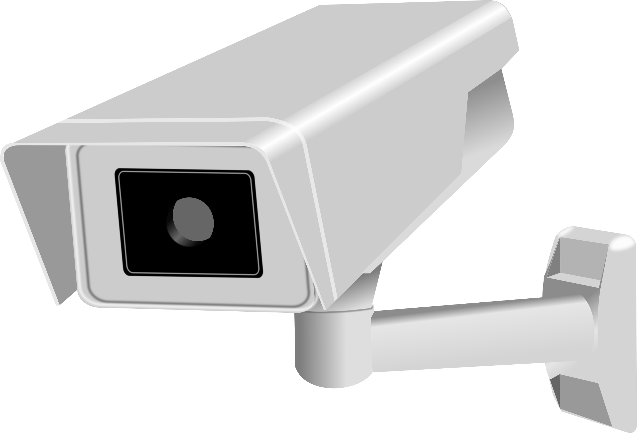
What is video Surveillance?
People aware surveillance areas (banks, convenience stores, prisons, gambling casinos, traffic and cab drivers)
After 2001 terrorist attacks, installation of high zoomed cameras ½ mile range.
Spy Surveillance: Cameras + face recognition apps violate civil liberty issues.
Police in Tampa Florida scan faces of 1lac fans and employees in Super Bowl (snooper/spy). Then matches computer files criminal matches in their DB of suspects.
In two years of no wanted recognized. (Face rec poor accuracy in 2001)

Slide 4

What is cloud computing?
It is an emerging computer technology that uses the internet and central remote servers to maintain the data and applications.
It refers to the applications and services offered over the internet.
These services are offered from the data centers all over the world, which collectively referred to as cloud.

Slide 5
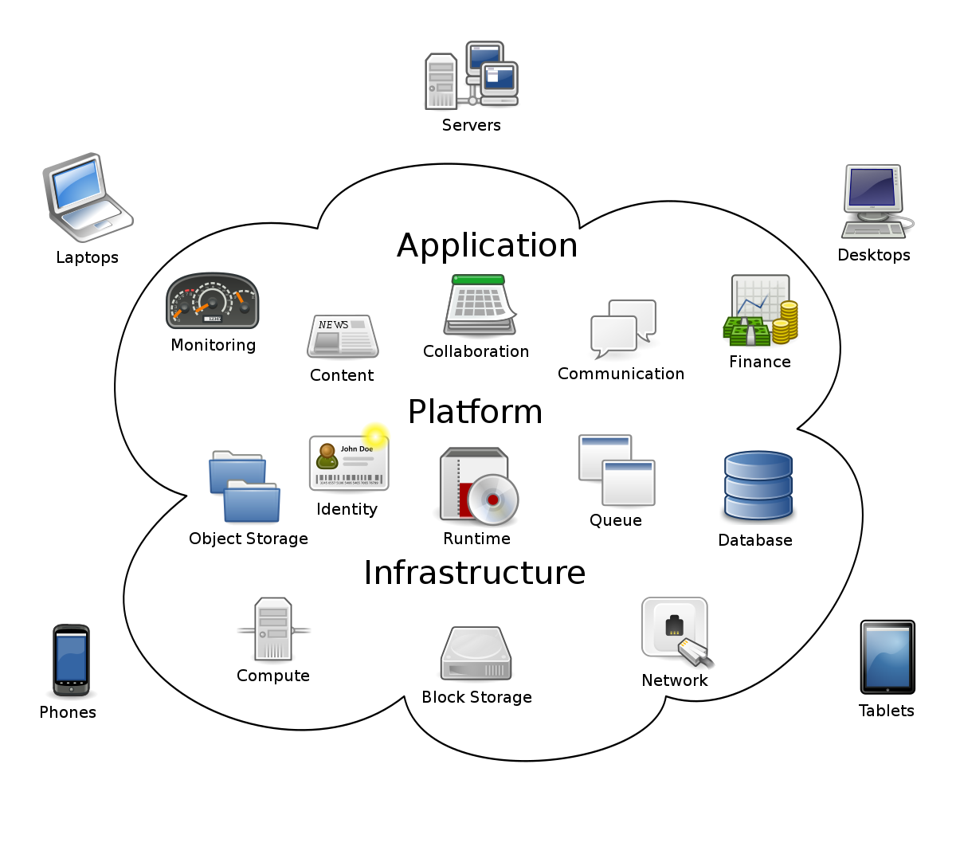
Cloud computing

Slide 6

Surveillance systems and cloud computing
Due to increase in population and highly specific security areas, intelligent monitoring is the major requirement of modern world.
Surveillance over the cloud computing benefits a boost to surveillance systems at the time reducing cost and maintenance.
Cloud computing provides a major challenge and opportunities for researchers to make surveillance systems highly efficient.

Slide 7
Key applications
Abnormality detection and warnings
Identification of specific persons can aid police
Statistical overview of crowd and analysis of congestion
Control access for people in some security areas

Slide 8
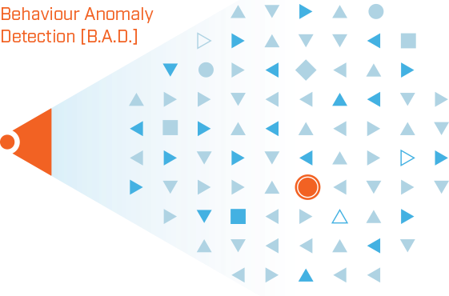
Abnormality detection and warnings
It is an application of surveillance systems to scrutinize the etiquettes of people and vehicles.
It also helps to determine them as normal or abnormal in certain situations.
Usually there are two methodologies of warning:
To automatically make a recorded public announcement whenever any abnormal behavior is detected.
Other is to contact the police automatically.

Slide 9
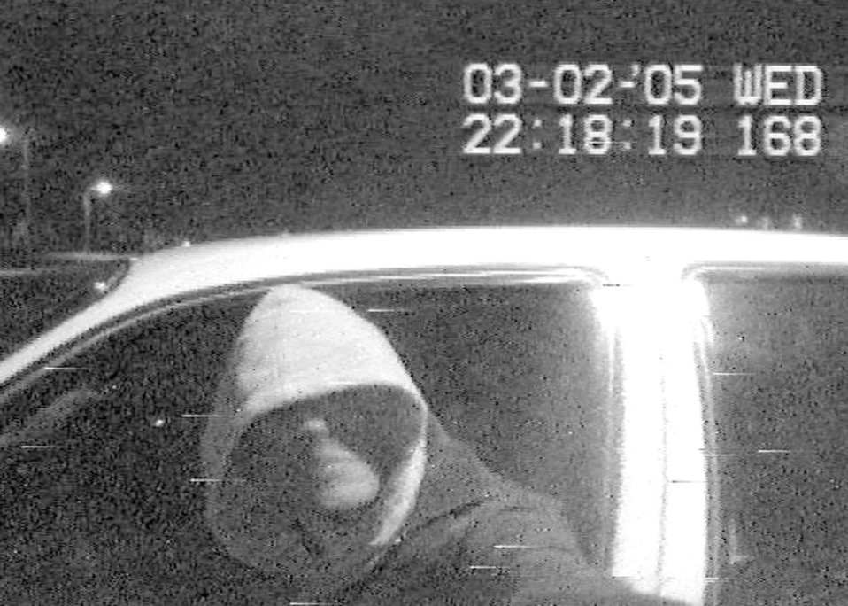
Identification of specific persons can aid police
Police can build database with bio-metric details of the suspect and establish visual surveillance in certain public areas:
Bus stop
Railway stations
Markets
Whenever a surveillance system recognize a suspect, immediately location of the of the suspect will be updated to the police.

Slide 10
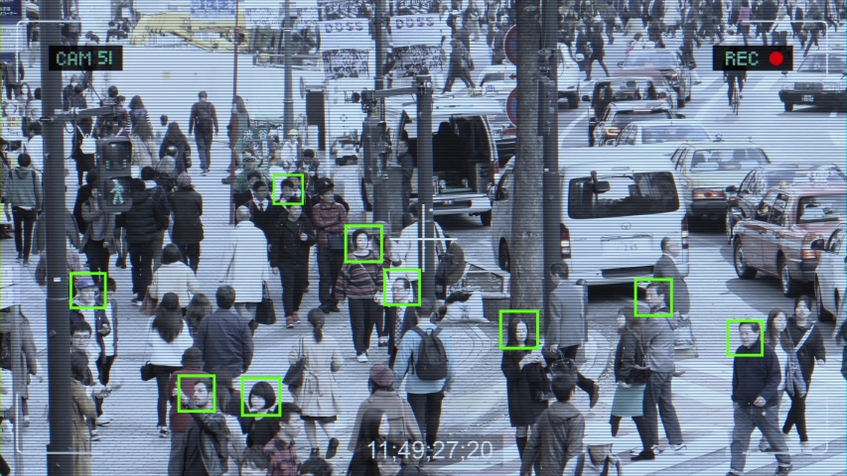
Statistical overview of crowd and analysis of congestion
Surveillance can also be used for statistical overview of crowd and congestion analysis in certain areas:
Markets
Major roads
Football grounds etc.
Again, this information can be provided to the police and government to adequate action to control and manage people.

Slide 11
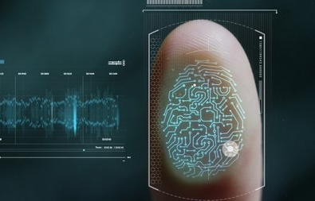
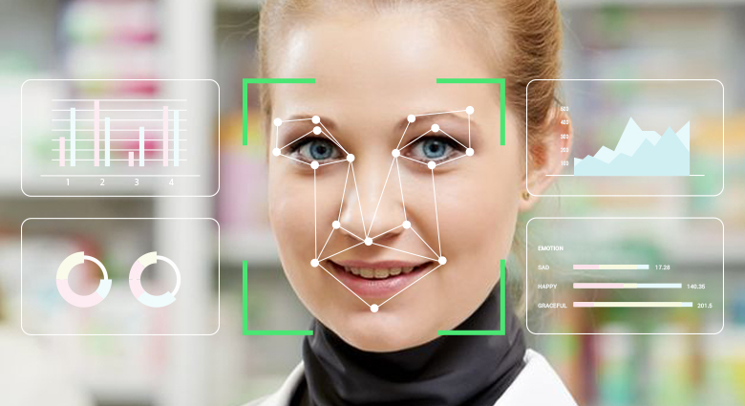
Control access for people in some security areas
Control access for people in some security sensitive areas, such as:
Hospitals
Military
Govt. authorities and units
Agencies
This require special identification, such as biometric identification.
Surveillance system will automatically recognize a person real time through his characters, such as:
Height,
Walking gait

Slide 12

Future challenges and opportunities
Transmission of data to mobile agent
Scalability
Privacy
Energy efficiency
Bandwidth
Fusion of data from multiple sensors

Slide 13
An architecture of generalized visual surveillance system

Slide 14
VIGILANT Surveillance System
It is a multi-camera surveillance system that generates video reports from previous events.
It is utilized to monitor the pedestrians walking in a parking lot.
It tracks people using software agents.

Slide 15
Thank You!

